Slide 1
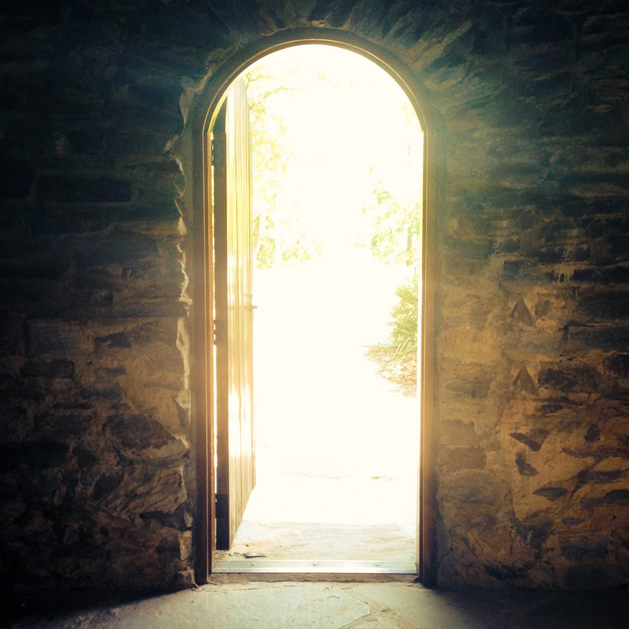
Welcoming the King of Glory Encounter Service 11 Aug 2018 Cecil Ang

Slide 2
Psalm 24 (ESV)
¹ The earth is the Lord's and the fullness thereof, the world and those who dwell therein, ² for he has founded it upon the seas and established it upon the rivers.
³ Who shall ascend the hill of the Lord? And who shall stand in his holy place? ⁴ He who has clean hands and a pure heart, who does not lift up his soul to what is false and does not swear deceitfully. ⁵ He will receive blessing from the Lord and righteousness from the God of his salvation. ⁶ Such is the generation of those who seek him, who seek the face of the God of Jacob. Selah

Slide 3
Psalm 24 (ESV)
⁷ Lift up your heads, O gates! And be lifted up, O ancient doors, that the King of glory may come in. ⁸ Who is this King of glory? The Lord, strong and mighty, the Lord, mighty in battle! ⁹ Lift up your heads, O gates! And lift them up, O ancient doors, that the King of glory may come in. ¹⁰ Who is this King of glory? The Lord of hosts, he is the King of glory! Selah

Slide 4
Message Outline
The Greatness of God (v 1-2)
Man entering divine domain (v 3-6)
God entering human domain (v 7-10)

Slide 5
The Greatness of God (v 1-2)
¹ The earth is the Lord's and the fullness thereof, the world and those who dwell therein, ² for he has founded it upon the seas
and established it upon the rivers.
Not just a deity of Israel
And a man of God came near and said to the king of Israel, “Thus says the Lord, ‘Because the Syrians have said, “The Lord is a god of the hills but he is not a god of the valleys,” therefore I will give all this great multitude into your hand, and you shall know that I am the Lord.’” 1 Kg 20:28 ESV

Slide 6
The Greatness of God (v 1-2)
¹ The earth is the Lord's and the fullness thereof, the world and those who dwell therein, ² for he has founded it upon the seas
and established it upon the rivers.
Creator and owner of the earth
“For every beast of the forest is mine, the cattle on a thousand hills. I know all the birds of the hills, and all that moves in the field is mine. If I were hungry, I would not tell you, for the world and its fullness are mine.” Ps 50:10-12 ESV
To him who spread out the earth above the waters, for his steadfast love endures forever. Ps 136:6 ESV

Slide 7
Man entering divine domain (v 3-4)
³ Who shall ascend the hill of the Lord? And who shall stand in his holy place?
Hill of the Lord
Mount Zion (city of David); 765 m in elevation
Where the tent was pitched for the ark of the covenant to rest – tabernacle of David. And where Solomon eventually built the temple of the Lord.

Slide 8
Man entering divine domain (v 3-4)
⁴ He who has clean hands and a pure heart, who does not lift up his soul to what is false and does not swear deceitfully.
Clean Hands (Actions) – ceremonial uncleanness
“Thus you shall keep the people of Israel separate from their uncleanness, lest they die in their uncleanness by defiling my tabernacle that is in their midst.” Lev 15:31 ESV

Slide 9
Man entering divine domain (v 3-4)
⁴ He who has clean hands and a pure heart, who does not lift up his soul to what is false and does not swear deceitfully.
Clean Hands (Actions) – Unclean Lips
“You shall not bear false witness against your neighbor.” Ex 20:16 ESV
“Woe is me! For I am lost; for I am a man of unclean lips, and I dwell in the midst of a people of unclean lips; for my eyes have seen the King, the Lord of hosts!” Is 6:5 ESV
“No human being can tame the tongue. It is a restless evil, full of deadly poison.” Jas 3: ESV

Slide 10
Man entering divine domain (v 3-4)
⁴ He who has clean hands and a pure heart, who does not lift up his soul to what is false and does not swear deceitfully.
Pure Heart (Intentions)
And David was angry because the Lord had broken out against Uzzah. And that place is called Perez-uzza to this day. And David was afraid of God that day, and he said, “How can I bring the ark of God home to me?” 1 Chron 13:11-12 ESV

Slide 11
Man entering divine domain (v 3-4)
⁴ He who has clean hands and a pure heart, who does not lift up his soul to what is false and does not swear deceitfully.
Pure Heart (Intentions)
“You shall have no other gods before Me.” Ex 20:3 ESV
⁵ Therefore put to death your members which are on the earth: fornication, uncleanness, passion, evil desire, and covetousness, which is idolatry. ⁶ Because of these things the wrath of God is coming upon the sons of disobedience, ⁷ in which you yourselves once walked when you lived in them. ⁸ But now you yourselves are to put off all these: anger, wrath, malice, blasphemy, filthy language out of your mouth. Col 3:5-8 NKJV

Slide 12
Man entering divine domain (v 3-4)
⁴ He who has clean hands and a pure heart, who does not lift up his soul to what is false and does not swear deceitfully.
Pure Heart (Intentions)
“For the word of God is living and active, sharper than any two-edged sword, piercing to the division of soul and of spirit, of joints and of marrow, and discerning the thoughts and intentions of the heart.” Heb 4:12 ESV
“You ask and do not receive, because you ask wrongly, to spend it on your passions.” Jas 4:3 ESV

Slide 13
Man entering divine domain (v 5-6)
⁶ Such is the generation of those who seek him, who seek the face of the God of Jacob. Selah – reflective pause
Seek God’s face
“Blessed are the pure in heart, for they shall see God.” Mt 5:8 ESV
“Draw near to God, and he will draw near to you. Cleanse your hands, you sinners, and purify your hearts, you double-minded.” Jas 4: 8 ESV

Slide 14
Man entering divine domain (v 5-6)
⁵ He will receive blessing from the Lord and righteousness from the God of his salvation.
God seekers shall be blessed
“Blessed is the one whose transgression is forgiven, whose sin is covered. Blessed is the man against whom the Lord counts no iniquity, and in whose spirit there is no deceit.” Ps 32:1 ESV
“I acknowledged my sin to you, and I did not cover my iniquity; I said, “I will confess my transgressions to the Lord,” and you forgave the iniquity of my sin.” Ps 32:5 ESV

Slide 15
God entering human domain (v 7-10)
⁷ Lift up your heads, O gates! And be lifted up, O ancient doors, that the King of glory may come in. ⁸ Who is this King of glory? The Lord, strong and mighty, the Lord, mighty in battle! ⁹ Lift up your heads, O gates! And lift them up, O ancient doors, that the King of glory may come in. ¹⁰ Who is this King of glory? The Lord of hosts, he is the King of glory! Selah
Repetitions are usual in songs, and used for emphasis.
Ancient gates had no parts that moved up and down; this is a personification. To lift one's head to rejoice at the coming of a great God and King.
Opening the gates – welcoming the King of glory in.

Slide 16
Applications
Does God own everything you have? How is your stewardship of things entrusted to you?
Are you a God-seeker? Do you have clean hands and a pure heart?
“But we are all like an unclean thing, and all our righteousnesses are like filthy rags …” Is 64:6 NKJV
Won’t you welcome the King of Glory into your heart?
But if we walk in the light as He is in the light, we have fellowship with one another, and the blood of Jesus Christ His Son cleanses us from all sin. If we say that we have no sin, we deceive ourselves, and the truth is not in us. If we confess our sins, He is faithful and just to forgive us our sins and to cleanse us from all unrighteousness. 1 Jn 1:7-9 NKJV

